Slide 1

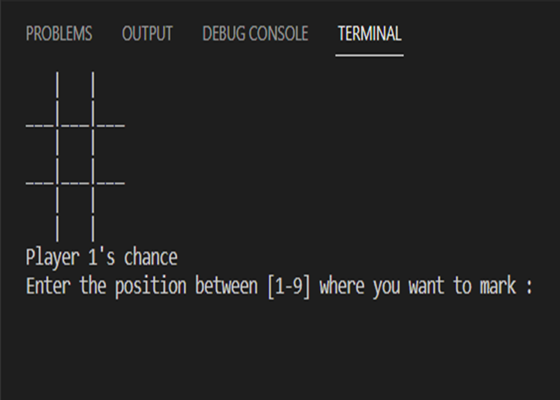
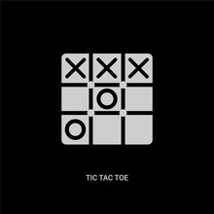

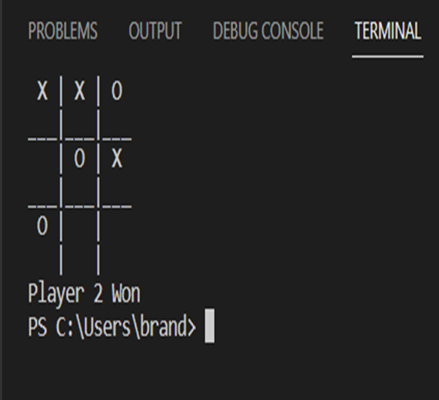
Tic-Tac-Toe Game
By: Xavier Cannady
This is a simple game of Tic-Tac-Toe created using a “drawboard()” function and you mark your position on board using keys 1-9.
https://github.com/xcannadyksu/Tic-Tac-Toe-Game-By-Brandon-Richards-

